Slide 1
Indoor Street View Gouri Joshi Technology Leadership Program Intern Terence Zhao Technology Analyst Intern Mobile Innovation Team, Online Business Unit 08/17/2012

Slide 2
Introduction
Problem Statement
Provide a visual context to enrich the customer shopping experience and customer engagement
Bridge the gap between the 2 dimensional store floor map and the real world store
The Solution
Indoor Street View
Project Description
The Indoor Street View project takes advantage of popular technologies such as Google Maps and enhances them with our own SKIN (Sears Kmart Indoor Navigation) technology to allow users to experience our stores as if they were really there
Create a new format for shopping online and paving the way for the store of the future
Notes:
As more of the world becomes digital, even physical spaces can now be explored online. This provides widespread accessibility and convenience for customers who want to preview our stores. The Indoor Street View project takes advantage of popular technologies such as Google Maps and enhances them with our own SKIN (Sears Kmart Indoor Navigation) technology to allow users to experience our stores as if they were really there. By providing the immersive experience of navigating indoor locations, we are creating a new format for shopping online and paving the way for the store of the future.

Slide 3
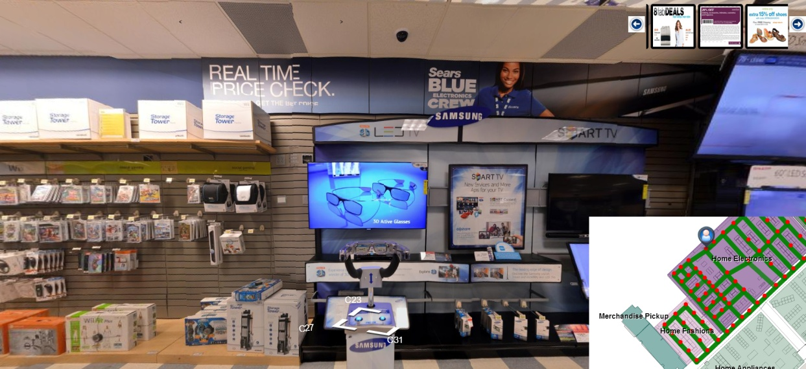





Overview
Indoor Street View
Panoramas
Database of locations, panoramas
Google Map Street
View API’s
Sears Kmart Indoor Navigation APIs
Deals Engine
Notes:
Deal Engine – Shop Local or any other deals database

Slide 4
The Process
Plan Locations
Visit store
Plot points on floor map
Take pictures and Create panoramas
iPad vs DSLR
Image Stitching
Process images
Resize images
Cut into image tiles
Build Indoor Street View
SKIN Generic Builder Interface
Street View Builder Interface
Google Maps API;s
SKIN Webview API’s

Slide 5
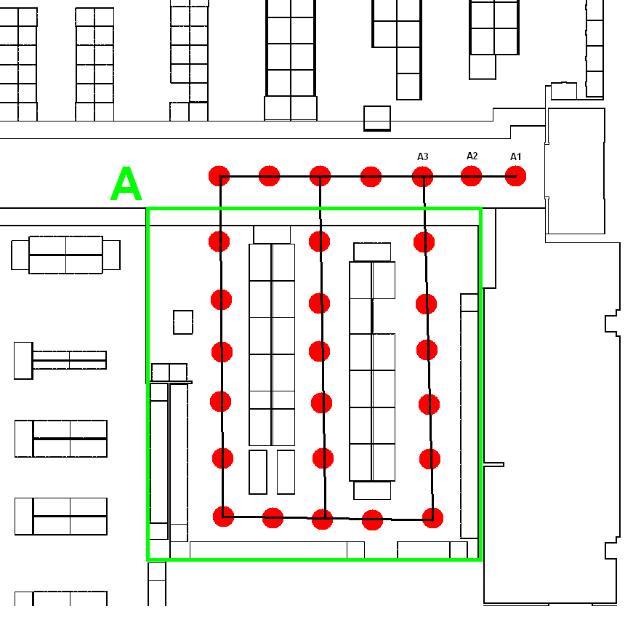
Plan Locations
Scout for main departments and aisles
Identify paths within each department
Pick locations about 2 feet apart
Plot and label each location on map

Slide 6
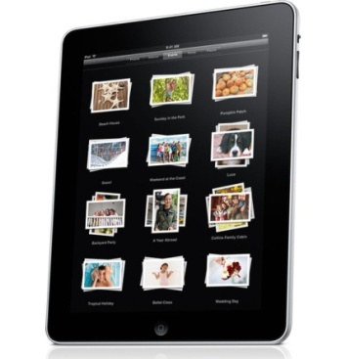
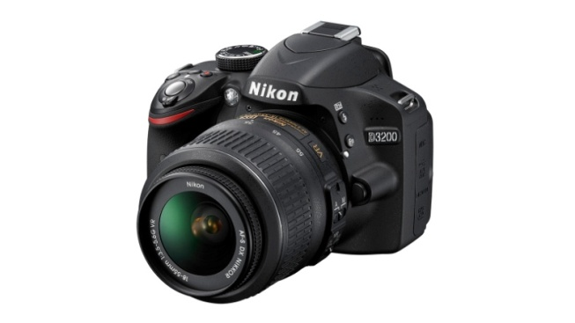




Creating Panoramic Images
Take images by hand by panning
Stitches automatically
Produces panoramas quickly
No control over stitching errors
Low resolution images
Use tripod & wide angle lens
High resolution images
More customizable
Requires separate stitching software
Stitching images can be time consuming
Photosynth
360 Panorama
Microsoft ICE
Hugin

Slide 7
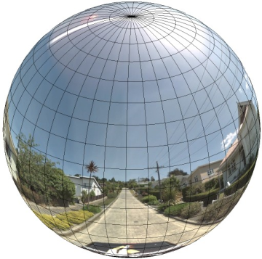
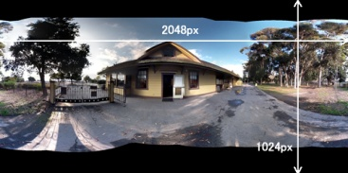
Processing Images
Resize images
For accurate rendering resulting images must be 2:1 ratio for equirectangular projection

Slide 8
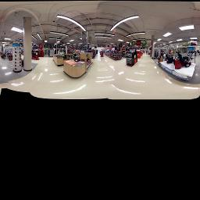
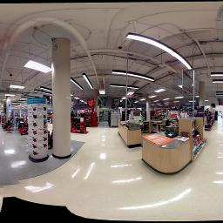
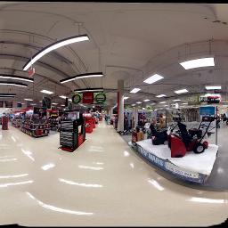
Processing Images
Zoom levels – Panoramas are divided into varying number of image tiles to support zoom
To support 5 zoom levels – 2731 tiles per panorama. Each tile is 256x256.
Cut images for zoom levels – PhotoOverlay creator 1.0
Image Naming Convention - pano_zoom_x_y.jpg
Zoom level 0 img_0_0_0.jpg
Zoom level 1(img_1_0_0.jpg, img_1_0_1.jpg)
Notes:
Rectilinear coordinate system is advantageous when dividing up the image into rectilinear tiles, and serving images based on computed tile coordinates.

Slide 9
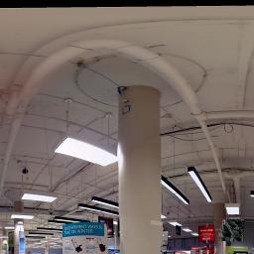
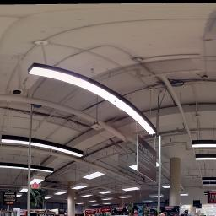
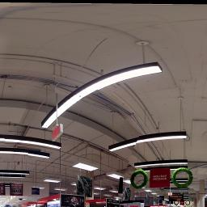
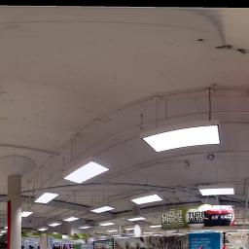
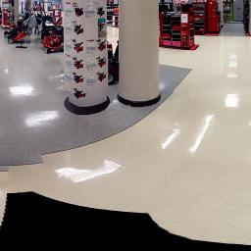
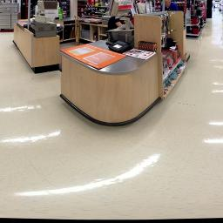
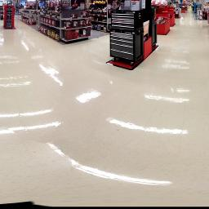
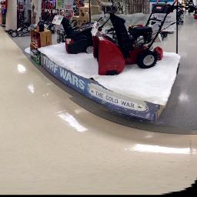
Processing Images
Zoom level 2
Img_2_0_0.jpg Img_2_1_0.jpg Img_2_2_0.jpg Img_2_3_0.jpg
Img_2_0_1.jpg Img_2_1_1.jpg Img_2_2_1.jpg Img_2_3_1.jpg

Slide 10
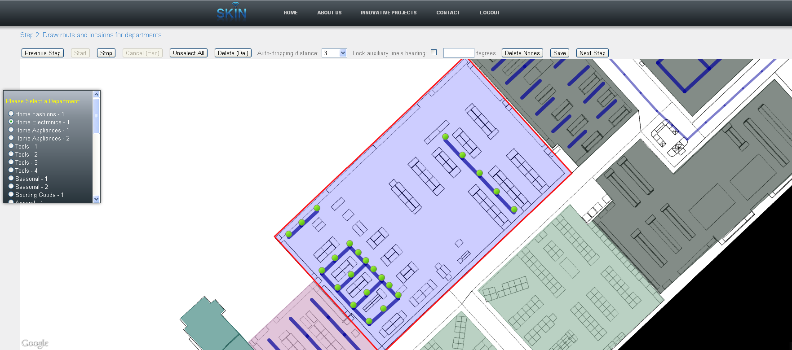
Building Indoor Street View
SKIN Generic Builder Interface
A tool we used to add locations to the database
Allows us to draw points and paths for each department

Slide 11
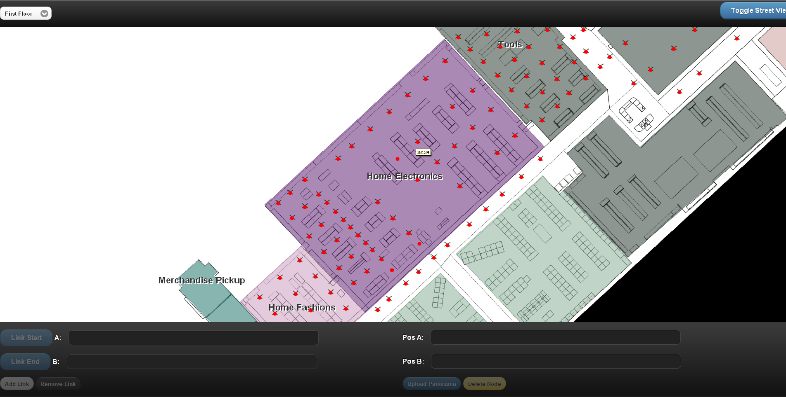
Building Indoor Street View
Street View Builder Interface
Uploads panoramas to server
Attaches panorama to a location id
Creates links between panoramas
Preview street view
Adjust headings

Slide 12
Building Indoor Street View
Google Maps APIs
Street View
Displays Panoramas and Link arrows (google.maps.StreetViewPanorama)
Overlays
Place markers to show current location and POIs(google.maps.Marker)
Polyline paths show links between panoramas (google.maps.Polyline)
SKIN API’s (Sears Kmart Indoor Navigation)
skin.webview to display store map

Slide 13
Integrating Deals
Deals can be presented in 2 ways –
Department level deals
Individual product deals
Department level deals
The Process –
Identify users current location
Identify the department
Get relevant deals for the department
Deals can be fetched from any deals engine like Shop Local
Refreshing deals
User clicks on links or loads new panoramas
Individual product deals
Define clickable regions on the panorama
Associate deal with a specific position on the streetview
Future scope - Integrate with a planogram and locate each product position in the store

Slide 14
Indoor Street View demo for Sears at Woodfield
Scale of the project
2 floors
Xxxx locations
Xxxx photos – yy GB

Slide 15
Success Metrics and Results
Success Metrics
Create panoramas for one department and link them together
Enable zooming into price labels for products
Link to Deals Engine
Result
Create a working model for entire Sears store at Woodfield
Support for 5 levels of zoom that can display tags and prices
Linked to Deals database that refreshes deals based on customer location

Slide 16
Opportunity and Challenges
Opportunity
B2C - First mover in retail to offer virtual tour of the store with integrated deals.
B2B - Opportunity to patent the process and offer as a service to other businesses (Eg: Malls, Airport)
Allows Sears to push new in-store initiatives to users using a virtual tour and draw customers to their stores. (Eg: Fit Studio)
Gives the customers an opportunity to view the store online and review the products.
Challenges
Scaling process to hundred of stores
Maintaining privacy of customers captured in panoramas
Blurring out outdated deals on the panoramas
Adapting to constantly changing floor plans

Slide 17
Future Roadmap
Automate processes using robotics and store builder interface
Integrate with Planogram to identify location of each product and add product specific deals
Provide detailed zoom level that displays 3D models of shelves and items
Integrate with augmented reality project to allow users to shop virtually
Allow users to scan any view in the store with mobile device and receive information, deals, direction, etc. by matching image data against panoramas.

Slide 18
Our Learning
Javascript
JBoss, MySQL
jQuery, jQuery Mobile
Android, phoneGap
Google Maps APIs
SLR Photography
Image stitching/processing
Insight from working in a large corporation in the midst of a transformation.
Managing time and balancing responsibilities in order to deliver a product
Web development – Webviews, JBOSS, JSON, Web services
Andriod development
Managing a project from design to development to execution
A good lesson in planning and why foresight is important
An insight into the fast moving retail industry
Gouri
Terence

Slide 19
Acknowledgements
Panorama clicking Team - Brian, Peng, Xiaomei, Harsh
Woodfield Maps - Brian, Kamran
Woodfield Builder Interface - Cheng-Hsin
Web Services – Mamta
Backend Setup – Vlad
Goodman and Steven for their support and help!
The Mobile Innovation team - For your support and motivation!

Slide 20
Questions?

Slide 21
THANK YOU

Slide 22
Gouri Joshi & Terence Zhao
Notes:
Use a topic title slide each time a new person is presenting or a new topic is presented.

